Slide 1
ROCKSTAR, PILOT, ACCOUNTANT? How to have great career conversations with young people

Slide 2
A ‘flattened’ world is bringing a shakeout of traditional ways of working, in which those who enjoy what they do and provide unique value will really prosper….
Thomas Friedman (The World is Flat, 2005)

Slide 3
Purpose of the talk
Understanding the different ‘hats’ we wear as parents… Q: how can we Coach?
Guidelines to structure conversations around potential careers
Strategies to help clarify thinking
Practical resources online that we can use to inform our choices, decisions and direction
Interactive

Slide 4
What ‘hats’ do we wear to support positive career conversations?
Mentor – draws upon their own experience and know-how to provide guidance and direction
Advisor – offers solutions
Friend / Confidante – will listen and hold information in confidence
Devil’s Advocate – challenge with a differing view
Coach - through effective questioning and listening we encourage the person being coached to elicit solutions for themselves
What’s the best hat to wear?

Slide 5
Careers and discovering potential options
4 step process
My interests and what I enjoy
My ‘transferable’ skills / abilities & my personality traits
How they combine and link to potential careers
What can I do now? Taking action
NB : Objective is not to get to the right answer straight away, it is to get thinking. This is a creative and ongoing process!
TIP : do it for yourself at the same time!!

Slide 6
CONFUSION
………………..immediately precedes………
LEARNING

Slide 7
My interests and what I enjoy
Ask :
What are your interests, what are your hobbies?
What subjects do you enjoy most? Why?
In your free time what do you like to do?
In the magazine section of a shop, which magazines do you look for? Why? (go beyond ‘Heat’ and ‘Now’!)
You won the Lotto and it meant you didn’t have to work for money ever again, you splashed out and then got bored...how would you like to spend your time?
What would your dream job be? What would your NIGHTMARE job be?! Why exactly?
Write down everything that is said – filter out any jokey responses and look for patterns – circle these

Slide 8
Interests.. thinking about my ‘Type’ of People
You are at a party and there are 6 groups of different people
A : Artistic - Artistic, Imaginative, Innovative (Invent / Create it!)
S : Social - like to help, teach and be of service (Share it!)
E : Enterprising – like to start up projects / organisations, like to influence or persuade people (Start or Sell it!)
C : Conventional – they like detailed work and to complete tasks and projects (Keep it going!)
R : Realistic – they like nature, athletics, tools and machinery (Do it!)
I : Investigative – they are very curious and like to investigate and analyse things (Explore it!)

Slide 9
Exercise
You can only attend the party for 60 minutes and will be able to visit and talk to only three of the groups
The first group you can speak to for 30 minutes, the second group 20 minutes and third group 10 minutes
Which group will you go to first?
Which group second?
Which group third?
Write down why you chose these groups and what you see in yourself that is similar to them
Write down the letters (from previous slide) in that order e.g. IAS

Slide 10
My ‘transferable’ skills/abilities & my personality traits
Speed-Interviewing:
2 minutes to tell me all of the reasons someone would be lucky to employ you
They write answers, then 2 minutes to sell themselves
Write down everything they say
You present them with your own list (written in advance) …a random survey of recent employers!
Note : It is vital that your list reflects attributes they really HAVE not what you would LIKE them to have!

Slide 11
My ‘transferable’ skills/abilities & my personality traits
Speed-Dating :
2 minutes to tell me all of the reasons someone should go out with you!
Let them prepare then sell themselves...you write down everything they say
In advance prepare your own list and tell them this is the result of a random survey you did! Add these to their own list

Slide 12
At My Best (transferable skills/abilities continued)
Pick an activity or project you were involved in and that you enjoyed e.g. Writing a paper, Organising an activity / event, Learning something new
What were doing that made this enjoyable / successful? Ask them to describe everything that was going on and you take notes
If they are stuck prompt with questions :
- how many people were involved / around,
- what were you doing physically (moving, running, lifting, fixing, building),
- what did you have to work out in your head / what information was needed?

Slide 13
Join the dots and brainstorm!
Have fun with this...the rule is that no idea is a stupid one!
Look at the patterns from the ‘Interests’ exercises and those from the ‘Skills/Abilities/Personality’ exercises
Q : What careers could someone with these interests and strengths embark upon?
Again write down all ideas and at the end they circle the three that excite them most!

Slide 14
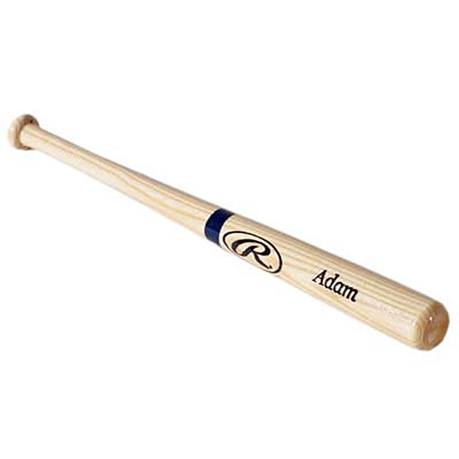
You buy a bat and a ball
Together they cost $1.10
The bat costs $1 more than the ball
How much does the ball cost?

Slide 15
Supporting the Brainstorm!
For every potential job or potential option we identify we can explode this out to a host of other areas - there are job ‘families’ or ‘clusters’ we can explore e.g. ‘Computer & Mathematical’ or ‘Arts, Design & Media’ have a number of different occupations relating to them
Develop ‘Fields of Fascination’ : for every ‘Interest’ area there are a number of different ways to make a living around this – doing it, making it, promoting it / selling it, organising it, writing about it, researching / creating something new in the field e.g. the Film Industry …. Acting, Producing, Directing , PR, Advertising, Finance, Communications, Agents, Camera, Editing, CAD etc…

Slide 16
Supporting the Brainstorm!

Slide 17
Let’s Brainstorm an example………….

Slide 18
Interests / Enjoy Doing :
Cooking, Fun with Friends, Charity, Philosophy / Religion, Coffee, Music, Stock market investing (school competition), Making money! (Social) teaching, helping others, (Enterprise) start business, new ideas. At my best : doing grinds for younger students
Subjects: Bus.Org, Economics, Religion & Civics
Speed Dating :
Outgoing, Caring, Good Listener, Open, Friendly, Sociable, Love to talk!
Speed Interview :
Enthusiastic, Good with numbers, Hard-working, Enterprising, Confident, Good with people

Slide 19
The ‘Easy Way’
Either cacareerzone.org : US-centric site but with TONS of information around careers – do a free Interest Profiler (Holland Code) or careersportal.ie (Irish website)
Go to careersportal.ie , click on @schools / @college
Then click on Junior Cert / Transition Year / Leaving Cert
- Explore Career Interests – based on Holland Code
- Skills
- Personality
- Career reports
TIP : Do one yourself !!

Slide 20
Supporting the Brainstorm!
The previous links will even show you videos describing that kind of career, what they do, how much it pays, things they need to know and things they need to be able to do…Careersportal will even drill down into CAO courses that support progressing to these jobs
Go to www.onetonline.org and enter a job title...it will give you not only the skills and knowledge etc needed but also a work ‘context’ what it’s like – outdoors etc
Ref. Book : ‘What Colour is your Parachute for Teens’ & ‘Sorted’
www.WikiHow.com : How to do Anything!

Slide 21
Take Action!
Research – find out
Network – talk to people

Slide 22
Thank you !
email: roger@coachingpotential.com
phone : 0867789744

