Slide 1
The Impact of technology on family life
Gonzaga 2018
Colman Noctor

Slide 2
How to be a parent in 2017
Make sure your child’s
Academic, social, psychological, spiritual and nutritional needs are met,
Ensuring you don’t over-stimulate, under-stimulate or helicopter them,
Provide a screen-free, processed food free, negative-energy free, body positive, socially conscious environment that nurtures but fosters independence, is gentle but not over-permissive
In a two-storey home, with a back garden and 1.5 siblings, spaced evenly apart…..
Not forgetting the coconut oil….

Slide 3
Being a parent in literally every generation prior to now
Keep them safe and feed them sometimes

Slide 4
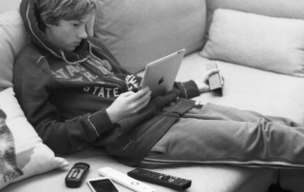
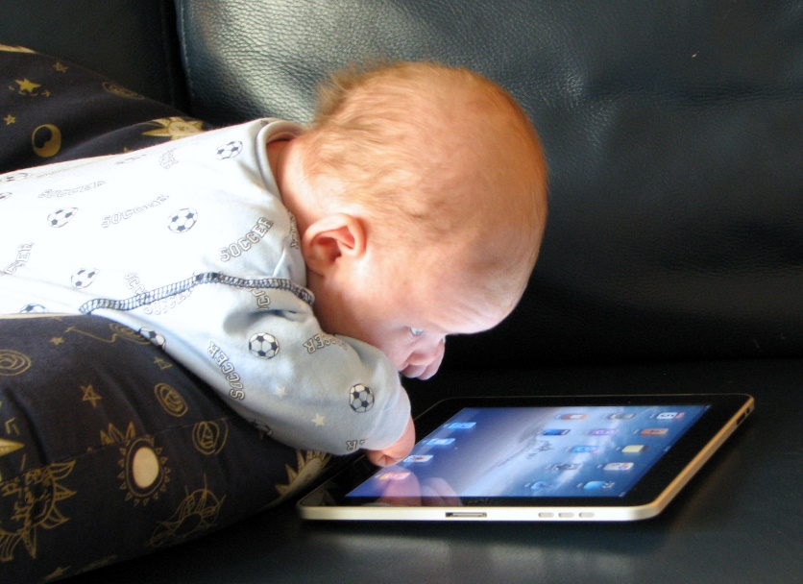
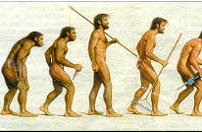
The task of parenting has been made much more challenging with the advent of technology

Slide 5
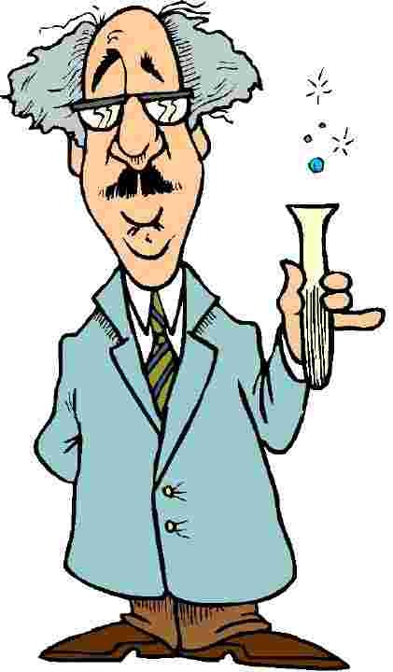
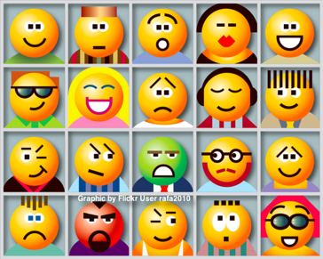
Therefore, Is the internet the greatest social experiment of our time?
The introduction of technology has impacted on
Family life
Communication
Relationships
Work lives
Our relationships with ourselves

Slide 6
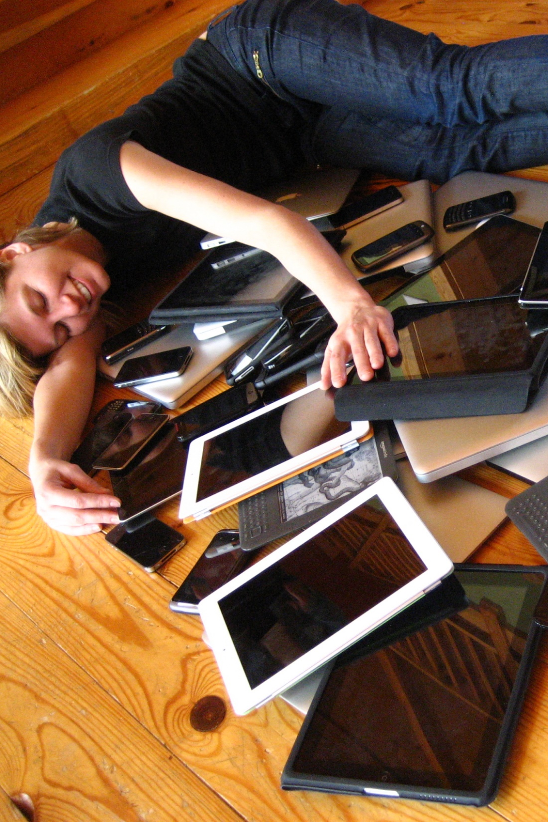
Not an alarmist approach
I love technology
I recognise its benefit to convenience
There are many pluses to the tech evolution
I just wonder because we have invited it so openly into our lives and our families, have we asked enough questions? Or the right questions?

Slide 7
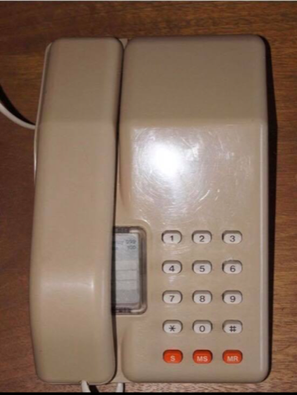
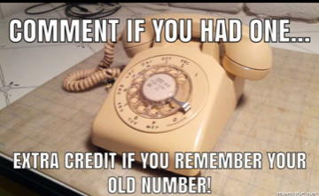
Sample Footer Text
11/26/2018
7

Slide 8
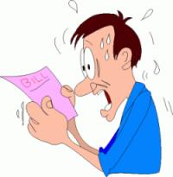
There were two regulators

Slide 9
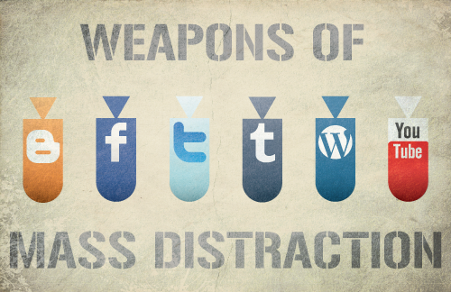
Now access is unlimited……

Slide 10
Why was this important to me?
My introduction to the technological seduction
My 1st status update
New presentations and insights
Clinical is the thin end of the wedge
Regulation a core task of adolescence but not a feature of the online world

Slide 11
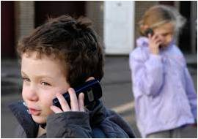
Myths of Digital Immigrants and Digital Natives
Not so much an issue anymore
The change in conversation in recent years
Different methods of communicating and relating
All they have ever known..
The trick behind the magic
A question of what is being missed, in terms of skills..

Slide 12
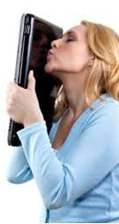
But its too neat to just blame this on young people,
Us adults are in on this too

Slide 13
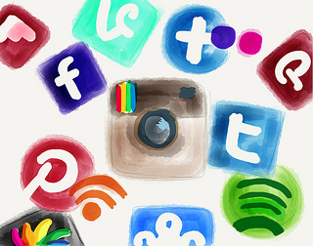
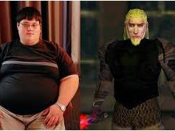
What harm?
Because we can now edit, cut and paste ourselves we can bypass the messiness of relationships.
Co-presence
Comparative Culture
Pre-figurative society
Has this had a negative impact on our mental health?
Pseudo-celebrity?

Slide 14
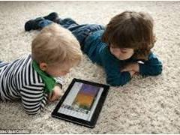
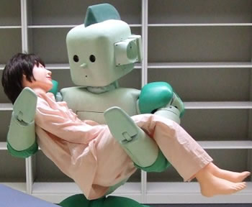
As technology becomes more humanised are we becoming less humanised?

Slide 15
There is no app for your lap

Slide 16
The impact of an 'On Demand' Culture
Sold an idea of ‘On Demand’ happiness
No expectation of delaying gratification
No 'Learning to wait'

Slide 17
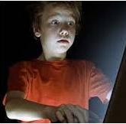
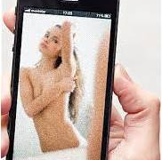
Regulation an issue of adolescence
FOMO
Sexualisation
Cyber-bullying
Viral scandals

Slide 18
All you can eat Data Binge Watch

Slide 19
Increase in expectation equals an increase in demand and perhaps an increase in unhappiness

Slide 20
The unspoken tech challenge
If we get past the distraction of technology, the impact on obesity, social communication and predatory risks, there are other risks to identity.
The arms race for attention
Google and Apple are town planners of a global village
No ethical obligations
Providing users with what we desire not what we need
These structures influence our time, our choice architecture and our exposure to truth…

Slide 21
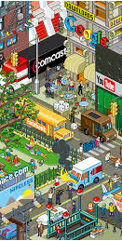
The Internet like a city....
Prohibition not the answer
Rapunzel Parenting
Regulation is the issue
Need to develop internal regulation which is a lot to ask

Slide 22
The Anti-Boredom Device
the removal of reflection
How do we get to know ourselves if we are not given an opportunity?

Slide 23
Identity and getting to know yourself

Slide 24
The Importance of identity to develop a sense of self
Our sense of self is crucial to our experience of self-worth
It is what we draw upon to cope with adversity
It is a cornerstone of psychological health

Slide 25
The promotion of self-confidence over self-esteem
Are we becoming consumed by the cost of everything and the value of nothing?
Need to return to valuing effort instead of outcome

Slide 26
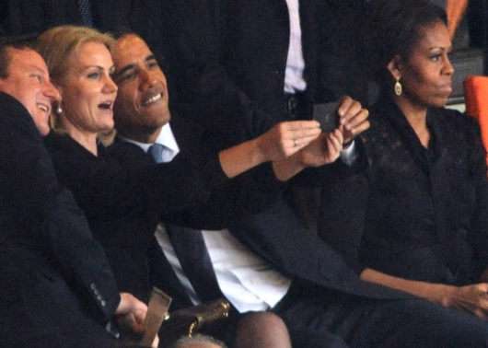
What fuels the fascination?
Recognition (selfie)
Validation (likes)
Feeling (response)
Capture more than experience
Meaning (It would be better if it moved)

Slide 27
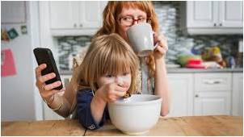
The importance of the gaze…
Technology and attachment
The allure of the smart phone
The newness of the relationship
Competition with the device
iPhone babies are not 9 yet!!!

Slide 28
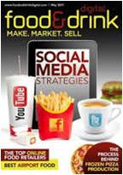
Social snacking
The junk food of communication
Needs to be moderated
We manage treats for children and regulate their desire
Why not the same with technology

Slide 29
It is about the relationship with technology
Its not bad technology, its bad usage!
But technology is not neutral

Slide 30
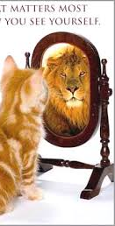
Viewing the world through the my lens
Self-esteem
Coping
Prioritisation
Context

Slide 31
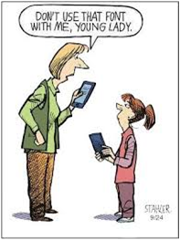
Competing with technology
In a world so short of time, time has never become more important
The need to entice children into ‘real’ relationships by role modelling these experiences
Filling in the gaps and becoming critical consumers
The counter-conversations

Slide 32
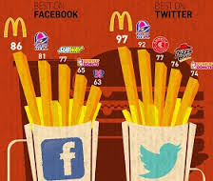
A need for conversation
We need to return to having a conversation
We need to teach children how to challenge the tech discourse
This can happen through role modelling and discussion
We need to disconnect and connect

Slide 33
The consensus of the given moment
I am trying to make friends outside of Facebook by applying the same principles. Everyday I walk down the street and tell passers-by what I have eaten, how I feel, what I did the night before a and what I will do later, and with whom. I show them pictures of my family, my dog and me gardening, standing in front of landmarks and having lunch. I also listen to their conversations and give them the “thumbs up” and tell them I like them. And it works! I already have four people following me, 3 Garda and a psychiatrist.

Slide 34
Jar of stones

Slide 35
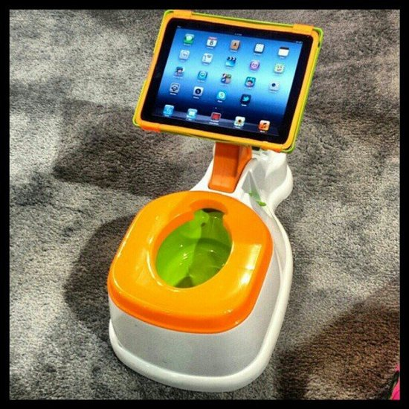
We need to up our game THO ;-)

